Slide 1


Project Phase-I
Analysis of malicious URLs using Machine Learning
Project team members:
Ankita Aditya 1PE17CS023
Atul K Uchil 1PE17CS029
Mitali Singh 1PE17CS182
Prescilla Angel 1PE18CS419
Guide: Prof Sudeepa Roy Dey
1
Notes:
1

Slide 2
Analysis of malicious URLs using Machine Learning
Problem definition
Malicious Web Sites is a cornerstone of Internet criminal Activities. It is one of the most important issue on web. We often click on some random URLs which redirect us to a malicious websites without our concern. Many such URLs are increasing at a rapid speed day-by-day. The model that we are proposing uses lexical analysis, which parses the URL and identify whether it’s malicious or benign. We are adding a chrome extension to alert the users in real time, thereby protecting the users from these malicious URLs.
Guide: Prof Sudeepa Roy Dey
2
Notes:
2

Slide 3
Analysis of malicious URLs using Machine Learning
Requirements
Non- Functional Requirements:
Usability: Degree to which a product or system can be used by specified users to achieve specified goals with effectiveness, efficiency, and satisfaction in a specified context of use.
Security: Degree to which a system protects information and data, so that persons or other products or systems have the degree of data access appropriate to their types and levels of authorization.
Performance: Performance relative to the amount of resources used under stated conditions.
Availability: Describes how likely the system is accessible for a user at a given point in time.
Functional Requirements:
Product Feature:- Real-time detection for safe URLs.
User Requirements:- Download chrome extension.
Guide: Prof Sudeepa Roy Dey
3
Notes:
3

Slide 4
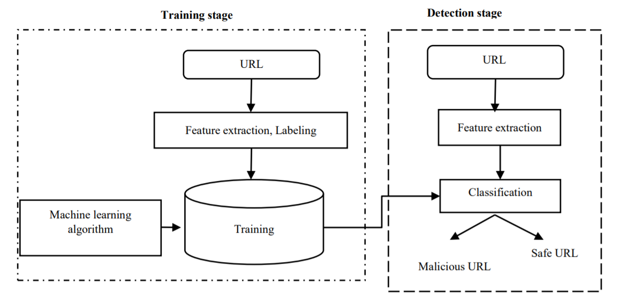
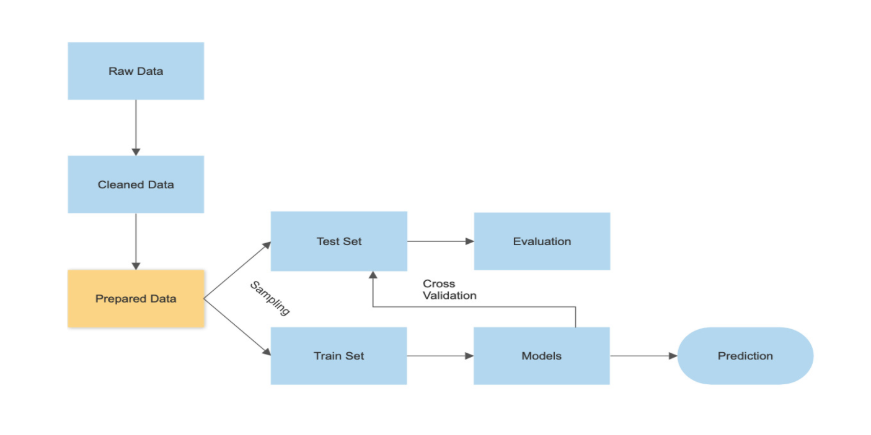
Analysis of malicious URLs using Machine Learning
Data Flow Diagrams
Guide: Prof Sudeepa Roy Dey
4
Notes:
4

Slide 5

Analysis of malicious URLs using Machine Learning
Use case Diagram
Stores the input URL
Detect malicious URLs
Alert User
Proposed System
Store Blacklist
Store Previous History
Guide: Prof Sudeepa Roy Dey
5
Notes:
5

Slide 6
Analysis of malicious URLs using Machine Learning
Sequence Diagram
Client
Browser
Web Page
Sends request for an URL
Displays the requested web page
Role of extension
Activates extension
Reads the current visited URL
Stores the URL
Runs the algorithms to detect URL as malicious or benign
Sends result to the user
Stores the URL in blacklist or whitelist
6
Guide: Prof Sudeepa Roy Dey
Notes:
6

Slide 7
Analysis of malicious URLs using Machine Learning
State Transition Diagram
Lexical, Keywords, WHOIS
Online Update
Malicious URL
Input Sources
Start
Live URL Feed
Feature Collector
URL
Features extracted
Classifier
Results
End
Collection of labelled URL Data
Benign URL
Online Update
Guide: Prof Sudeepa Roy Dey
7
Notes:
7

Slide 8
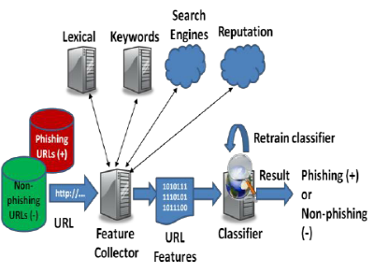
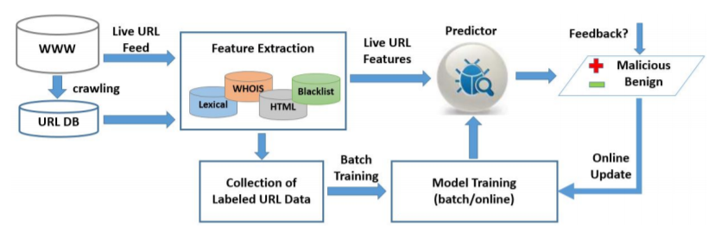
Analysis of malicious URLs using Machine Learning
Detailed design
Class diagram (plus flowchart if relevant) if you are using the object-oriented approach
Flow charts and the modular decomposition if you are following the non OO approach.
Guide: Prof Sudeepa Roy Dey
8
Notes:
8

Slide 9
Analysis of malicious URLs using Machine Learning
The development environment
The development environment helps the developers to develop the application or product using a set of processes and programming tools.
The Programing tools that we use in analysis of malicious URLs using machine learning are : Python, Pycharm-IDE, Windows OS, Spyder, Jupiter Notebook.
Guide: Prof Sudeepa Roy Dey
9
Notes:
9

Slide 10
Analysis of malicious URLs using Machine Learning
Implementation approach
The detection of malicious URLs is one of the highest priority issues for cyber security practitioners. Despite the large number of studies that have examined different machine learning techniques to address the issue, The main obstacle of using machine learning is the difficulties in data collection.
Incremental Representation: Incremental approach aims to adapt the training models according to the arriving data without forgetting the acquired knowledge. Incremental Learning transfers the acquired knowledge from different batches to classify the test data. It helps to grow the network capacity by overcoming the problem of catastrophic interference i.e., successive training of each batch of newly arrived data causes the network to forget the previously acquired knowledge partially or completely. This type of learning is applied to the data streams to provide accurate results addressing the issues of, limited computational resources such as memory and time and the phenomenon of concept drift (changes in the distribution of data which occurs in a stream over time).
Guide: Prof Sudeepa Roy Dey
10
Notes:
10

Slide 11
Analysis of malicious URLs using Machine Learning
Documentation status
Project is currently on process and done with the
Problem statement
Literature survey [4 Papers]
Proposed Methodology
Requirements and Non functional requirements
Data flow diagram
Use case diagram
Sequence diagram
State Transition Diagram
Detailed design
The development environment
Implementation approach
Pre-processing of data
Model-making
Guide: Prof Sudeepa Roy Dey
11
Notes:
11

